Slide 1
Unit – V Code Generation and Optimization)
BSc CSIT 5th Semester
2020
Mid-Western University, Surkhet
Prepared By:
Dabbal Singh Mahara

Slide 2
Code Generator
Code generator is the final phase of compiler which takes as input intermediate representation produced by front end along with the relevant symbol table information and produces as output a symantically equivalent target code.
The output of intermediate code generator may be given directly to code generation or may pass through code optimization before generating code.
Code produced by compiler must be correct and be of high quality.
Source-to-target program transformation should be semantics preserving and effective use of target machine resources.
Heuristic techniques should be used to generate good but suboptimal code, because generating optimal code is undecidable.

Slide 3
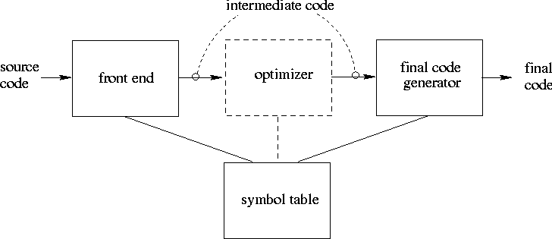
Code Generation
This phase generates the target code consisting of assembly code.
1. Memory locations are selected for each variable;
2. Instructions are translated into a sequence of assembly instructions;
3. Variables and intermediate results are assigned to memory registers.

Slide 4
Issues in Design of Code generation:
Target code mainly depends on available instruction set and efficient usage of registers. The main issues in design of code generation are:
Input to the Code Generator
The Target Program
Instruction Selection
Register Allocation
Evaluation Order

Slide 5
Input to the Code Generator
The input to the code generator is
The intermediate representation of the source program produced by the front-end along with the symbol table.
Choices for the IR
Three-address representations such as 3AC: quadruples, triples, indirect triples
Virtual machine representations: bytecode
Linear representations: postfix notation
Graphical representation: syntax tree, DAG’s
Prior to code generation, the front end must be scanned, parsed and translated into intermediate representation along with necessary type checking. Therefore, input to code generation is assumed to be error-free.

Slide 6
The Target Program
The output of the code generator is the target program. The output may be :
Absolute machine language - It can be placed in a fixed memory location and can be executed immediately.
Relocatable machine language - It allows subprograms to be compiled separately.
Assembly language - Code generation is made easier.
The instruction-set architecture of the target machine has a significant impact on the difficulty of constructing a good code generator that produces high-quality machine code.
The most common target-machine architecture are RISC, CISC, and stack based.
A RISC machine typically has many registers, three-address instructions, simple addressing modes, and a relatively simple instruction-set architecture.
A CISC machine typically has few registers, two-address instructions, and variety of addressing modes, several register classes, variable-length instructions, and instruction with side effects.
In a stack-based machine, operations are done by pushing operands onto a stack and then performing the operations on the operands at the top of the stack.

Slide 7
Instruction Selection
The code generator must map the IR program into a code sequence that can be executed by a target machine.
The instructions of target machine should be complete and uniform.
Instruction speeds and machine idioms are important factors when efficiency of target program is considered.
The quality of the generated code is determined by its speed and size. The former statement can be translated into the latter statement as shown below: Instruction selection is important to obtain efficient code
It depens upon the nature of instruction set architecture.
For each type of three address code, we can design a code skeleton that defines the target code to be generated. For example we translate three-address code x:=y+z
to: MOV y, R0 ADD z, R0 MOV R0, x
a:=a+1
MOV a,R0 ADD #1,R0 MOV R0,a
Cost = 6
Better
Better
ADD #1,a
INC a
Cost = 3
Cost = 2

Slide 8
Register Allocation
Accessing values in registers is much faster than accessing main memory.
A key problem in code generation is deciding what values to hold in what registers.
Efficient utilization is particularly important.
The use of registers is often subdivided into two sub problems:
Register Allocation, during which we select the set of variables that will reside in registers at each point in the program.
Register assignment, during which we pick the specific register that a variable will reside in.
Finding an optimal assignment of registers to variables is difficult, even with single-register machine.
Mathematically, the problem is NP-complete.

Slide 9
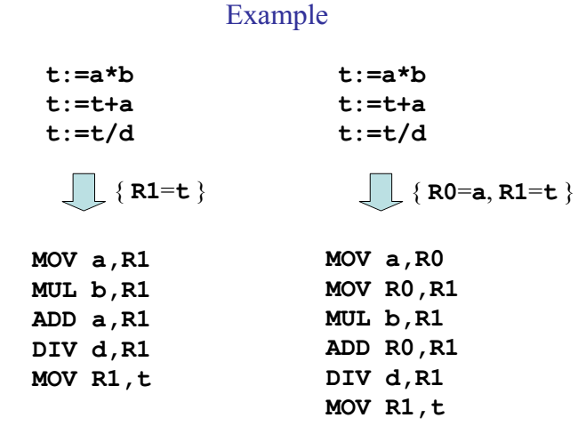
Register Allocation

Slide 10
Evaluation Order
The order in which computations are performed can affect the efficiency of the target code.
Some computation orders require fewer registers to hold intermediate results than others.
When the instructions are independent, their evaluation order can be changed.
However, picking a best order in the general case is a difficult NP-complete problem.

Slide 11
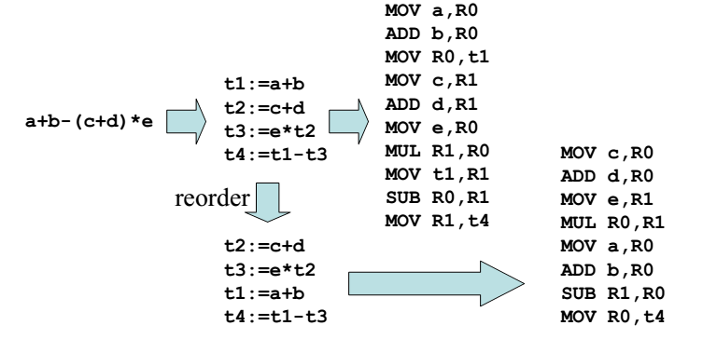
Evaluation Order

Slide 12
The Target Language
Familarity with the target machine and its instruction set is a prerequisite for designing a good code generator.
In this chapter, target language is assembly code for a simple computer that is representative of many register macnines i.e. A Simple Target Machine Model

Slide 13
A Simple Target Machine Model
Our target computer models a three-address machine with load and store operations, computation operations, jump operations, and conditional jumps.
The underlying computer is a byte-addressable machine with n general-purpose registers.
Assume the following kinds of instructions are available:
Load operations : LD r, x loads value in location x in register r.
Store operations: ST x, r stores value in register r in location x.
Computation operations: SUB r1, r2, r3 computes r1 = r2 – r3
Unconditional jumps: BR L causes control to branch to machine instruction with label L.
Conditional jumps: BLTZ r, L causes to jump to label L if the value in register r is less than zero.

Slide 14
Contd…
Assume a variety of addressing modes:
A variable name x referring o the memory location that is reserved for x , i.e. the l-value of x.
Indexed address, a ( r ), where a is a variable and r is a register.
For example: LD r1, a (r2) has the effect of setting r1 = contents( a + contents(r2)).
A memory can be an integer indexed by a register, for example, LD R1, 100(R2) has the effect of setting r1 = contents ( 100 + contents(R2)).
Two indirect addressing modes: *r means the memory location found in the location represented by the contents of register r. and *100( r ) means the location found in the location obtained by adding 100 to the contents of r. eg. LD r1, *100(r2)
Immediate constant addressing mode: LD r1, #100.

Slide 15
A Simple Target Machine Model
Example :
x = y –z ⇒ LD R1, y
LD R2, z
SUB R1, R1, R2
ST x, R1
x = *p ⇒ LD R1, p
LD R2, 0(R1)
ST x, R2
b = a[i] ⇒ LD R1, i
MUL R1, R1, 8
LD R2, a(R1)
ST b, R2
*p = y ⇒ LD R1, p
LD R2, y
ST 0(R1), R2

Slide 16
a[j] = c ⇒ LD R1, c
LD R2, j
MUL R2, R2, 8
ST a(R2), R1
if x < y goto L ⇒ LD R1, x
LD R2, y
SUB R1, R1, R2
BLTZ R1, L

Slide 17
Program and Instruction Costs
For simplicity, we take the cost of an instruction to be one plus the costs associated with the addressing modes of the operands.
The const corresponds to the length in words of an isntructions.
Addressing modes involving registers have zero additional cost, while those involving a memory location or constant in them have an additional cost of one, because such operands have to be stored in the words following the instruction.
Define the cost of instruction = 1 + cost(source mode) + cost(destination mode)
Mode | Form | Address | Added Cost
Register | R | R | 0
Absolute | M | M | 1
Indexed | C(R) | c + contents(R) | 1
indirect register | *R | contents(R) | 0
indirect Indexed | *C(R) | contents ( C + contents(R) | 1
Literal | #c | N/A | 1

Slide 18
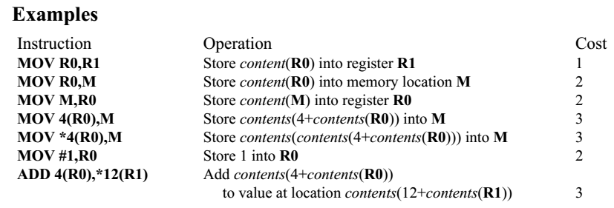
The three-address statement a : = b + c can be implemented by many different instruction sequences : i) MOV b, R0
ADD c, R0 cost = 6
MOV R0, a
ii) MOV b, a
ADD c, a cost = 6
iii) Assuming R0, R1 and R2 contain the addresses of a, b, and c :
MOV *R1, *R0
ADD *R2, *R0 cost = 2
In order to generate good code for target machine, we must utilize its addressing capabilities efficiently.

Slide 19
Addresses in the Target Code
Information needed during an execution of a procedure is kept in a block of storage called an activation record, which includes storage for names local to the procedure.
The two standard storage allocation strategies are:
Static allocation
Stack allocation
This section shows how the names in IR can be converte into addresses int the target code by looking at code generation for simple procedure calls and returns using static and stack allocation.
In static allocation, the position of an activation record in memory is fixed at compile time.
In stack allocation, a new activation record is pushed onto the stack for each execution of a procedure. The record is popped when the activation ends. The following three-address statements are associated with the run-time allocation and deallocation of activation records:
1. Call, 2. Return, 3. Halt, and 4. Action, a placeholder for other statements.

Slide 20
Basic Block
Definition: A basic block B is a sequence of consecutive instructions such that:
control enters B only at its beginning;
control leaves B at its end (under normal execution); and
control cannot halt or branch out of B except at its end.
This implies that if any instruction in a basic block B is executed, then all instructions in B are executed.
for program analysis purposes, we can treat a basic block as a single entity.

Slide 21
Example: Basic Block
The following sequence of three-address statements forms a basic block:
t1 : = a * a
t2 : = a * b
t3 : = 2 * t2
t4 : = t1 + t3
t5 : = b * b
t6 : = t4 + t5

Slide 22
Basic Block Construction
Determine the set of leaders, i.e., the first instruction of each basic block:
the entry point of the function is a leader;
any instruction that is the target of a branch is a leader;
any instruction following a (conditional or unconditional) branch is a leader.
For each leader, its basic block consists of:
the leader itself;
all subsequent instructions up to, but not including, the next leader.

Slide 23
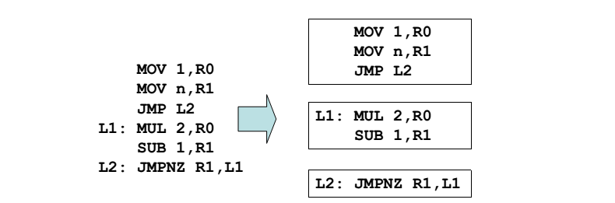
Example: Construct Basic Block

Slide 24
Example: Consider the following source code for dot product of two vectors
begin prod :=0; i:=1; do begin prod :=prod+ a[i] * b[i]; i :=i+1; end while i <= 20 end
The three-address code for the above source program is given as :
(1) prod := 0 (2) i := 1 (3) t1 := 4* i (4) t2 := a[t1] /*compute a[i] */
(5) t3 := 4* i (6) t4 := b[t3] /*compute b[i] */ (7) t5 := t2*t4 (8) t6 := prod+t5 (9) prod := t6 (10) t7 := i+1 (11) i := t7 (12) if i<=20 goto (3) Basic block 1: Statement (1) to (2)
Basic block 2: Statement (3) to (12)

Slide 25
Control Flow Graph
Definition: A control flow graph for a function is a directed graph G = (V, E) such that:
each v ∈ V is a basic block; and
there is an edge a → b ∈ E iff control can go directly from a to b.
Construction:
identify the basic blocks of the function;
there is an edge from block a to block b if:
there is a (conditional or unconditional) branch from the last instruction of a to the first instruction of b; or
b immediately follows a in the textual order of the program, and a does not end in an unconditional branch.

Slide 26
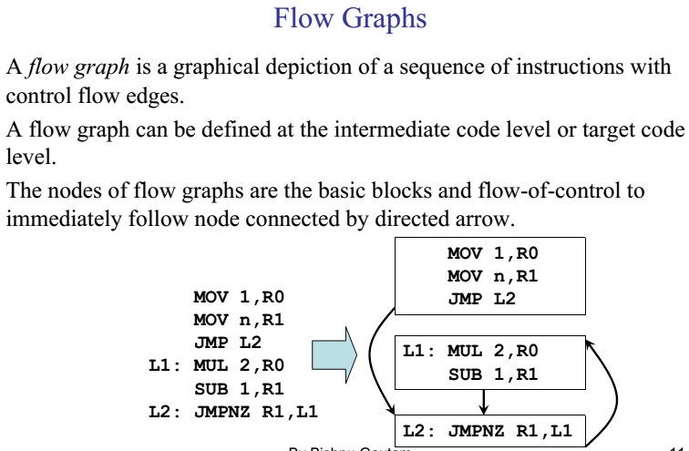
Fig. Flow graph

Slide 27
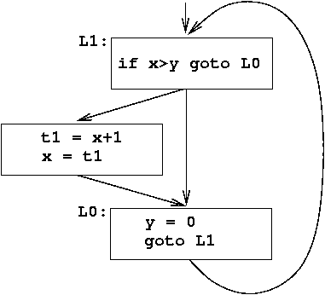
Basic Blocks and Flow Graphs
For program analysis and optimization, we need to know the program’s control flow behavior.
For this, we:
group three-address instructions into basic blocks;
represent control flow behavior using control flow graphs.
Example:
L1: if x > y goto L0
t1 = x+1
x = t1
L0: y = 0
goto L1

Slide 28
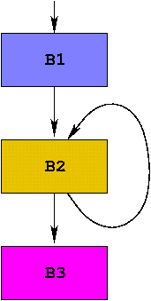
Example
int dotprod(int a[], int b[], int N)
{
int i, prod = 0;
for (i = 1; i ≤ N; i++) {
prod += a[i]∗b[i];
}
return prod;
}
No. | Instruction | leader? | Block No.
1 | enter dotprod | Y | 1
2 | prod = 0 |  | 1
3 | i = 1 |  | 1
4 | t1 = 4*i | Y | 2
5 | t2 = a[t1] |  | 2
6 | t3 = 4*i |  | 2
7 | t4 = b[t3] |  | 2
8 | t5 = t2*t4 |  | 2
9 | t6 = prod+t5 |  | 2
10 | prod = t6 |  | 2
11 | t7 = i+i |  | 2
12 | i = t7 |  | 2
13 | if i ≤ N goto 4 |  | 2
14 | retval prod | Y | 3
15 | leave dotprod |  | 3
16 | return |  | 3

Slide 29
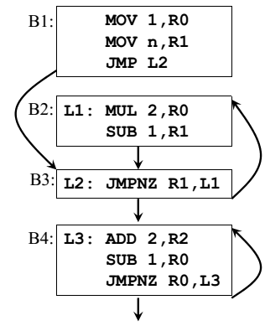
Loops
A loop is a collection of basic blocks, such that
All blocks in the collection are strongly connected
The collection has a unique entry, and the only way to reach a block in the loop is through the entry
Virtually every program spends most of its time in executing its loops, it is especially imoportant to generate good code for the loop
Many code transformations depend upon the identification of the loops in a flow graph.
Strongly connected components: { B2, B3}, {B4 } , There is a path of length one or more from one node to the another to make a cylcle.
Entry are: B3 and B4 for the loops.
A loop that consists of no other loop is called inner loop.

Slide 30
Optimizing of Basic Block
We can obtain a substantial improvement in the running time of code merely by performing local optimization within each basic block by itself.
More thorough global optimization, which looks at how information flows among the basic blocks of a program.
Some of local optimizations are:
Compile time evaluation
Common sub-expression elimination
Code motion
Strength Reduction
Dead code elimination
Algebraic Transformations

Slide 31
Compile-Time Evaluation
Expressions whose values can be pre-computed at the compilation time
Two ways:
Constant folding
Constant propagation
Constant folding: Evaluation of an expression with constant operands to replace the expression with single value.
Example:
area := (22.0/7.0) * r ^ 2
area := 3.14286 * r ^ 2

Slide 32
Compile-Time Evaluation
Constant Propagation: Replace a variable with constant which has been assigned to it earlier.
Example:
pi := 3.14286
area = pi * r ^ 2
area = 3.14286 * r ^ 2

Slide 33
Common Sub-expression Elimination
Local common sub-expression elimination is performed within basic blocks.
Compute the expression only once and assign it to some temporary
a := b * c
…
…
x := b * c + 5
temp := b * c
a := temp
…
…
x := temp + 5
temp := x * 2
If(a<b) then
z:= temp
else
y := temp + 2
If(a<b) then
z:= x * 5
else
y := x * 5 + 2

Slide 34
Code Motion
Moving code from one part of the program to other without modifying the algorithm
Reduce size of the program
Reduce execution frequency of the code subjected to movement
This transformation takes an expression that yields the same result independent of the number of times a loop is executed ( i.e. loop invariant computation) and evaluates the expression before the loop.
Similar to common sub-expression elimination but with the objective to reduce code size.
t = limit -2
while(i<=t)
{
......
}
while ( i <= limit -2)
{
.......
}

Slide 35
Strength Reduction
Replacement of an operator with a less costly one.
X = x ^ 2
Y = y * 2
X = x * x
Y = y + y

Slide 36
Dead Code Elimination
Dead Code are portion of the program which will not be executed in Basic block.
If(a==b)
{
b=c ;
…..
return b ;
c = 0 ;
}
If(a==b)
{
b=c ;
…..
return b ;
}
debug = FALSE;
...
if (debug)
print..........
debug = FALSE
..................
.................
............

Slide 37
Algebraic Simplification
• Some statements can be deleted x := x + 0 x := x * 1
• Some statements can be simplified
x := x * 0 ⇒ x := 0 y := y ** 2 ⇒ y := y * y x := x * 8 ⇒ x := x << 3 (on some machines << is faster than *; but not on all!)

Slide 38
NEXT-USE INFORMATION
We need to know, for each use of a variable in a basic block, whether the value contained in the variable will be used again later in the block.
If a variable has no next-use we can reuse the register allocated to the variable.
Next-use information is needed for dead-code elimination and register assignment (if the variable in a register is no longer needed, then the register can be assigned to some other variable).
We want to keep variables in registers for as long as possible, to avoid having to reload them whenever they are needed.
If, after computing a value X, we will soon be using the value again, we should keep it in a register. If the value has no further use in the block we can reuse the register.
x = y + z z = z * 5 t7 = z + 1 y = z – t7 x = z + y

Slide 39
Computing Liveness and next-use
If i: x = … and j: y = x + z are two statements i & j, then next-use of x at i is j.
Next-use is computed by a backward scan of a basic block and performing
the following actions on statement i : x = y op z
Add liveness/next-use info on x, y, and z to statement i (whatever in the symbol table). Assuming that symbol table initially shows all the non temporary variables in basic block as being live on exit.
Before going up to the previous statement (scan up):
Set x info to “not live” and “no next use”
Set y and z info to “live” and the next uses of y and z to i

Slide 40
Example:
Let us consider a basic block
t = a - b u = a – c v = t + u d = v + u
symbol | live | next-use
d | yes | non
u | yes | non
v | yes | non
Initially, consider all the variables as live ( variables taken for the last line only)

Slide 41
Example:
Step 1: Scan the last statement (4) and update live and next-use info
t = a - b u = a – c v = t + u d = v + u | # u, v: live ; next-use = 4
Symbol | Live | Next-use
d | No | non
v | Yes | 4
u | Yes | 4

Slide 42
Example:
t = a - b u = a – c v = t + u d = v + u | # u : live ; next-use = 3 # u, v: live ; next-use = 4
symbol | live | next-use
d | No | non
v | No | non
u | Yes | 3
t | Yes | 3
Step 2: Scan the statement ( 3 ) and update live and next-use info

Slide 43
Example:
t = a - b u = a – c v = t + u d = v + u | # a ; live; next-use = 2 # u : live ; next-use = 3 # u, v: live ; next-use = 4
symbol | live | next-use
d | No | non
v | No | non
u | No | non
t | yes | 3
a | yes | 2
c | yes | 2
Step 3: Scan the statement ( 2 ) and update live and next-use info

Slide 44
Example:
t = a - b u = a – c v = t + u d = v + u | # a: live; next-use = 2 # u: live ; next-use = 3 # u, v: live ; next-use = 4
symbol | live | next-use
d | No | non
v | No | non
u | No | non
t | No | non
a | yes | 1
c | yes | 2
b | yes | 1
Step 4: Scan the statement ( 1) and update live and next-use info

Slide 45
A Simple Code generator
This code generator algorithm generates code for a single basic block.
It considers each three address instructions in turn, and keeps track of what values are in what registers so it can avoid unnecessary load and stores.
Uses new function getreg to assign registers to variables
getreg has access to registers and address descriptors for all the variables of basic block and may also have access to certain data flow information such as the variables that are live on exit from the block.
Computed results are kept in registers as long as possible, which means: – Result is needed in another computation – Register is kept up to a procedure call or end of block
Checks if operands to three-address code are available in registers

Slide 46
Code Generation Algorithm
For each statement x := y op z 1. Set location L = getreg(y, z) // to store the result of y op z 2. If y ∉ L then generate //L is address descriptor MOV y’, L //to place copy of y in L
where y’ denotes one of the locations where the value of y is available (choose register if possible) 3. Generate instruction OP z’, L where z’ is one of the locations of z; Update register/address descriptor of x to include L 4. If y and/or z has no next-use and is stored in register, update register descriptors to remove y and/or z

Slide 47
Code Generation Algorithm For an instruction x = y OP z, the code generator may perform the following actions. Let us assume that L is the location preferably register where the output of y OP z is to be saved:
Call function getReg, to decide the location of L. Determine the present location register or memory of y by consulting the Address Descriptor of y.
If y is not presently in register L, then generate the following instruction to copy the value of y to L: MOV y’, L where y’ represents the copied value of y.
Determine the present location of z using the same method used in step 2 for y and generate the following instruction: OP z’, L where z’ represents the copied value of z. Now L contains the value of y OP z, that is intended to be assigned to x. So, if L is a register, update its descriptor to indicate that it contains the value of x. Update the descriptor of x to indicate that it is stored at location L.
If y and z has no further use, they can be given back to the system.

Slide 48
Register and Address Descriptors
These are two data structures to track status of registers and variables.
A register descriptor keeps track of what is currently stored in a register at a particular point in the code, e.g. a local variable, argument, global variable, etc. MOV a,R0 “R0 contains a”
An address descriptor keeps track of the location where the current value of the name can be found at run time, e.g. a register, stack location, memory address, etc. MOV a,R0 MOV R0, R1 “a in R0 and R1”

Slide 49
The getreg Algorithm
If y is stored in a register R and R only holds the value y, and y has no next use, then return R; Update address descriptor: value y no longer in R
Else, return a new empty register if available
Else, find an occupied register R;
Store contents (register spill) by generating MOV R, M for every M in address descriptor of y; Return register R
If not used in the block or no suitable register return a memory location

Slide 50
code generation Example : d= (a-b) + (a-c) + (a-c)
Three- address code:
t := a-b;
u := a-c;
v := t+u;
d := u+v;
Statements | Code generated | Register descriptor | Address descriptor
t = a-b | MOV a, R0 SUB b,R0 | R0 contains t | t in R0
u= a-c | MOV a, R1 SUB c,R1 | R0 contains t R1 contains u | t in R0 u in R1
v= t+u | ADD R1,R0 | R0 contains v R1 contains u | u in R1 v in R0
d= v+u | ADD R1,R0 MOV R0,d | R0 contains d | d in R0 d in R0 and memory

Slide 51
Code Optimization
Code Optimization phase is mainly used to optimize the code for better utilization of memory and reduce the time taken for execution.
Code optimization takes input from intermediate code generator and performs machine independent optimization.
Code optimizer may also take input from code generator and perform machine dependent code optimization.
Compilers that use code optimization transformations are called as optimizing compilers.
Code optimization does not consider target machine properties for optimization (like register allocation and memory management) if input is from intermediate code generator.

Slide 52
Contd...
It implies that amount of time taken for optimization should be very less when compared to the reduction of overall execution time. Generally, a fast non optimizing compilers are preferred for debugging programs.
Local Optimization: Consider each basic block by itself. (All compilers.)
Global Optimization: Consider each procedure by itself. (Mostcompilers.)
Inter-Procedural Optimization: Consider the control flow between procedures. (A few compilers do this.)

Slide 53
Peephole Optimization
Most of the compilers produce good code through careful instruction selection and register allocation.
A few use an alternative strategy: they generate naive code and then improve the quality of the target code by applying optimizing transformations to the target program.
This naive process of statement-by-statement code generation often produce redundant instructions that can be optimize to save time and space requirement of target program.
A simple but effective technique for locally improving the target code is peephole optimization, which examines a short sequence of target instructions in a window (peephole) and replaces the instructions by a faster and/or shorter sequence whenever possible.
Peephole optimization can also be applied directly after intermediate code generation to improve the IR.

Slide 54
contd...
The peephole is a small, sliding window on a program.
That is, the “peephole” is a short sequence of (usually contiguous) instructions – The optimizer replaces the sequence with another equivalent one (but faster) Typical optimizations: – Redundant instruction elimination – Flow-of-control optimizations – Algebraic simplifications – Use of machine idioms

Slide 55
Eliminating Redundant Loads and Stores
Consider
MOV R0,a MOV a,R0
The second instruction can be deleted because first ensures value of a in R0, but only if it is not labeled with a target label
Peephole represents sequence of instructions with at most one entry point
The first instruction can also be deleted if live(a) = false

Slide 56
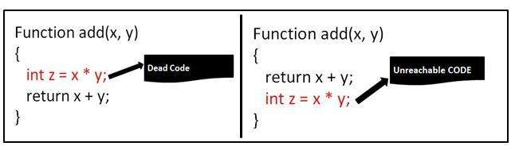
Eliminating unreachable code
– Code that is unreachable in the control-flow graph – Basic blocks that are not the target of any jump or “fall through” from a conditional – Such basic blocks can be eliminated

Slide 57
Using Machine Idioms
The target machine may have hardware instructions to implement certain specific operations efficiently.
Detecting situations that permit the use of these instructions can reduce execution time significantly.
For example, some machines have auto-increment and auto-decrement addressing modes.
Using these modes can greatly improve the quality of the code when pushing or popping a stack.
These modes can also be used for implementing statements like a = a + 1.
Eg. INC a

Slide 58
Algebraic Simplifications
If statements like:
a = a + 0
a =a * 1
are generated in the code, they can be eliminated, because zero is an additive identity, and one is a multiplicative identity.

Slide 59
Code hoisting
Moving computations outside loops
Saves computing time
In the following example (2.0 * PI) is an invariant expression there is no reason to recompute it 100 times.
DO I = 1, 100
ARRAY(I) = 2.0 * PI * I
ENDDO
By introducing a temporary variable 't' it can be transformed to:
t = 2.0 * PI
DO I = 1, 100
ARRAY(I) = t * I
END DO

Slide 60
Dead store elimination
If the compiler detects variables that are never used, it may safely ignore many of the operations that compute their values.
Dead code is code that is never executed or that does nothing useful. May appear from copy propagation:
T1 := k
...
x := x + T1
y := x - T1
...
...
x := x + k
y := x - k
...

Slide 61
Eliminating common sub-expressions
Optimization compilers are able to perform quite well:
X = A * LOG(Y) + (LOG(Y) ** 2)
Introduce an explicit temporary variable t:
t = LOG(Y)
X = A * t + (t ** 2)
Saves one 'heavy' function call, by an elimination of the common sub-expression LOG(Y), the exponentiation now is:
X = (A + t) * t

Slide 62
Induction Variable
A basic induction variable is
– a variable X whose only definitions within the loop are assignments of the form:
X = X+c or X =X=-c, where c is either a constant or a loop-invariant variable.
int a[SIZE]; int b[SIZE];
void f (void)
{
int i1, i2, i3;
for (i1 = 0, i2 = 0, i3 = 0; i1 < SIZE; i1++)
a[i2++] = b[i3++];
return;
}
The code fragment below shows the loop after induction variable elimination.
int a[SIZE]; int b[SIZE];
void f (void)
{
int i1;
for (i1 = 0; i1 < SIZE; i1++)
a[i1] = b[i1];
return;
}

Slide 63
Loop unrolling
The loop exit checks cost CPU time.
Loop unrolling tries to get rid of the checks completely or to reduce the number of checks.
If you know a loop is only performed a certain number of times, or if you know the number of times it will be repeated is a multiple of a constant you can unroll this loop.
Example:
// unrolled version
int i = 0;
colormap[n+i] = i;
i++;
colormap[n+i] = i;
i++;
colormap[n+i] = i;
// old loop
for(int i=0; i<3; i++)
{
color_map[n+i] = i;
}

Slide 64
Code Motion
Any code inside a loop that always computes the same value can be moved before the loop.
Example:
while (i <= limit-2)
do {loop code}
where the loop code doesn't change the limit variable. The subtraction, limit-2, will be inside the loop. Code motion would substitute:
t = limit-2;
while (i <= t)
do {loop code}

Slide 65
Thank You !

